Slide 1


Advanced Object Detection Techniques: Leveraging YOLO Algorithm for Real- Time Applications

Slide 2

Introduction to YOLO Algorithm
Introduction: Brief introduction of YOLO (You Only Look Once) Algorithm.
Origin: Introduced in 2015 by Joseph Redmon, Santosh Divvala, Ross Girshick, and Ali Farhadi.
Improvements: YOLO9000 and YOLOv3 are incremental improvements.

Slide 3
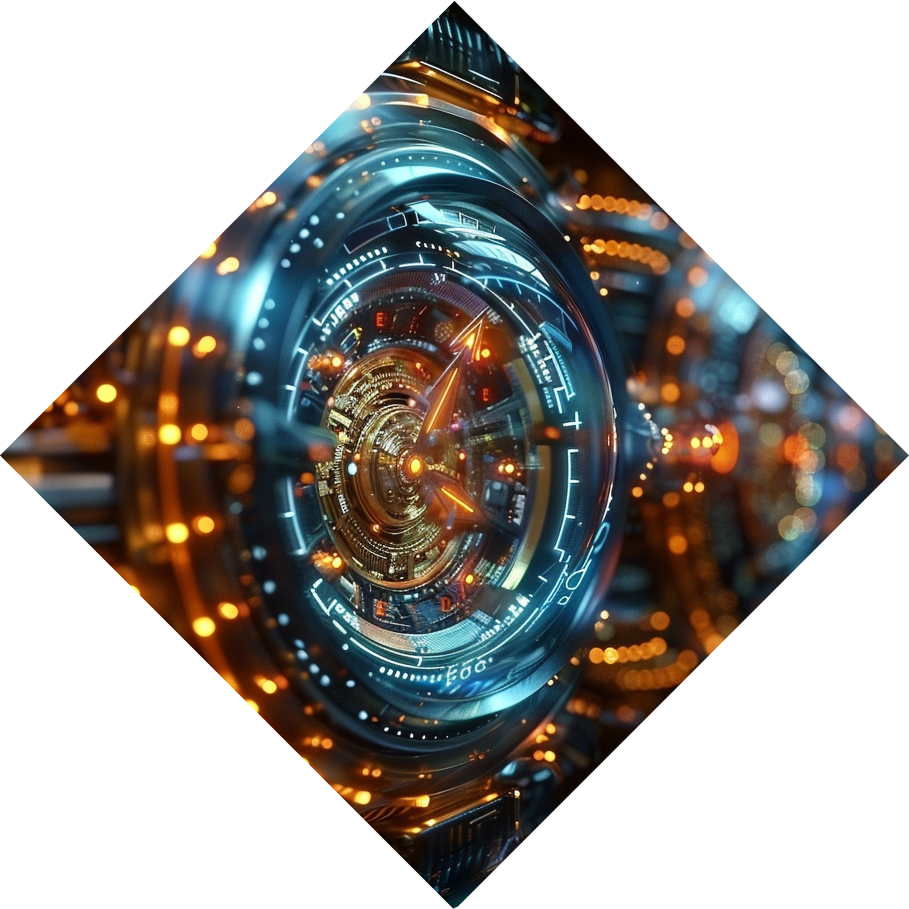
Need for Object Detection in Self-Driving Cars
Importance for Autonomous Vehicles::
Self-Driving Cars: Future of public transportation.
Limitations of Lidar: Expensive and accuracy issues.
Vision as an Alternative: Human-like visual data for driving.
Comparison with Traditional Methods::
Early Approaches: Viola-Jones Algorithm, Histograms of Oriented Gradients.
Limitations: Hand-coding features for each object.
YOLO Advantage: Works for all types of objects without specific coding.

Slide 4
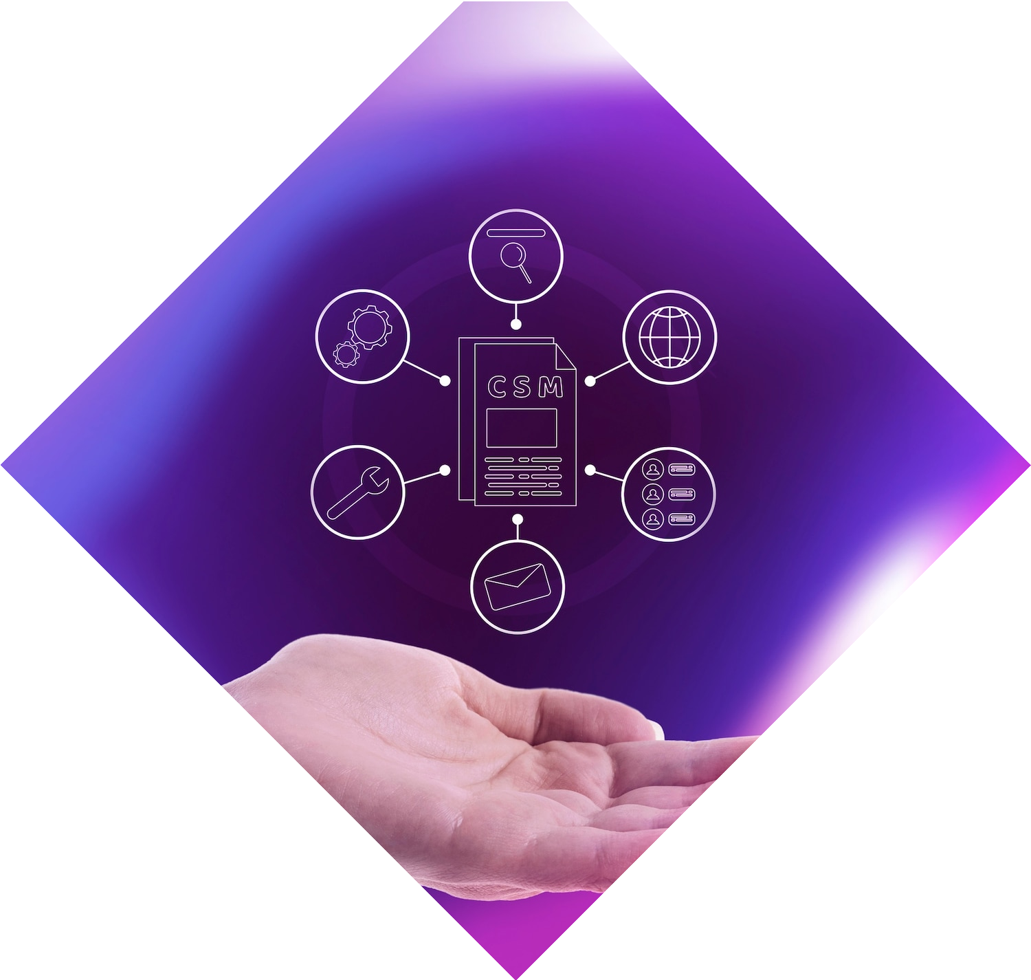
Understanding Convolutional Neural Networks
Convolution Layer:
Function: The convolution layer is designed to extract features from the input image. It applies a series of filters or kernels to the image to detect various features like edges, textures, and patterns. Each filter slides across the image and performs a dot product operation with the portion of the image it is covering, producing a feature map.
Hyperparameters:
Stride: Defines how much the filter moves with each step. A stride of 1 means the filter moves one pixel at a time.
Kernel Size: The dimensions of the filter (e.g., 3x3, 5x5). Larger kernels can capture more spatial information but increase computation.
Padding: Adds extra pixels around the edges of the input image to control the spatial dimensions of the output feature map and to ensure that features at the edges of the image are captured.
Pooling Layer:
Function: Pooling reduces the spatial dimensions of the feature maps, which helps in decreasing the computational load and controlling overfitting. It simplifies the representation by focusing on the most important features.
Types:
Max Pooling: Takes the maximum value from a feature map segment.
Average Pooling: Takes the average value from a feature map segment.

Slide 5
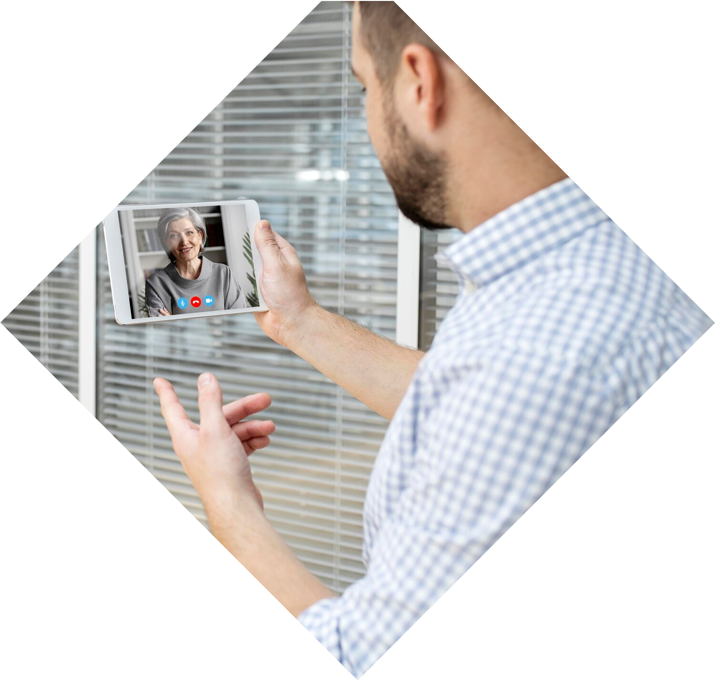
CNN Operations in Depth
Convolution Operation:
Feature Extraction:
Activation Functions:
Fully Connected Layers:
Function: The convolution operation involves sliding the filter across the image (or feature map) and performing element-wise multiplication followed by summing up the results. This operation generates a new feature map that highlights specific features of the input.
Process: Feature extraction involves identifying key aspects of the image, such as edges or textures, which are crucial for distinguishing different objects or patterns within an image.
Purpose: Activation functions introduce non-linearity into the network. Without these functions, the network would only be able to model linear relationships. ReLU (Rectified Linear Unit) is commonly used in CNNs due to its simplicity and effectiveness. It replaces negative values with zero, allowing for faster training and better performance.
Function: After feature extraction and pooling, the fully connected layers are responsible for making predictions. Each neuron in a fully connected layer is connected to every neuron in the previous layer, enabling the network to integrate information and make final predictions or classifications.

Slide 6
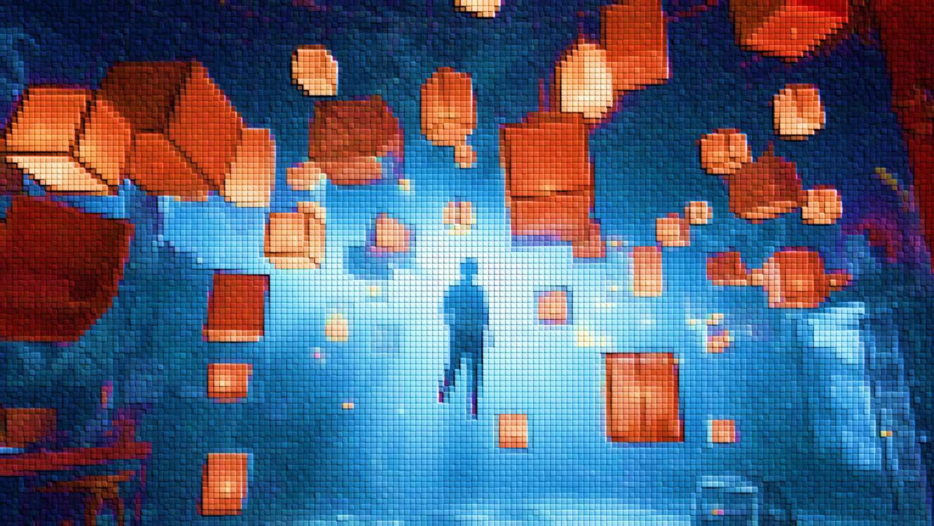
Integration of CNNs with YOLO
Importance of CNNs:
Role in YOLO: CNNs play a crucial role in YOLO (You Only Look Once) by performing efficient image processing. They are the backbone of YOLO’s object detection system, enabling the network to process and analyze images in real time.
Object Localization:
Function: YOLO predicts both the presence and location of objects within an image. It does this by dividing the image into a grid and predicting bounding boxes and class probabilities for each grid cell.
YOLO Algorithm in Action:
Sliding Window Algorithm: This traditional approach involves moving a fixed-size window across the image and making predictions for each window position. YOLO improves upon this by using a single pass through the network to predict bounding boxes and class labels for multiple objects.
Convolutional Implementation: YOLO employs CNNs to process the entire image at once, sharing computation across the entire image rather than processing each window separately. This results in faster and more efficient object detection.
Anchor Boxes: YOLO uses anchor boxes to predict multiple objects within the same grid cell. This approach allows the network to handle overlapping objects and improves detection accuracy.
Non-max Suppression: After predicting multiple bounding boxes for the same object, non-max suppression is used to eliminate redundant boxes. It compares the overlap (intersection over union) between boxes and keeps only the box with the highest confidence score.

Slide 7
Enhancing YOLO Efficiency and Future works
Feature Detection and Representation:
Hierarchical Extraction: CNNs in YOLO hierarchically extract features from images, capturing both low-level (e.g., edges) and high-level (e.g., object parts) information. This hierarchical approach allows YOLO to effectively identify and represent objects.
Real-Time Processing:
Mechanism: YOLO’s architecture, which uses CNNs and pooling layers, enables real-time processing by reducing computational complexity and speeding up the detection process. The network’s ability to process the entire image in one pass contributes to its efficiency.
Object Localization and Classification:
Grid-Based Prediction: YOLO divides the image into a grid and predicts bounding boxes and class probabilities for each grid cell. This grid-based approach simplifies the detection process and allows for simultaneous localization and classification of multiple objects.
Use of Anchor Boxes:
Purpose: Anchor boxes help YOLO handle objects of various sizes and shapes. By predicting multiple bounding boxes within each grid cell, YOLO can effectively detect and classify overlapping objects.

Slide 8
CONCLUSION
the YOLO algorithm is a powerful and efficient tool for object detection. Its ability to process images in real-time and detect multiple objects makes it ideal for various applications. Beyond self-driving cars, YOLO is used in security systems, robotics, and even medical imaging. As research continues, we can expect further improvements to YOLO and its applications in even more fields.

Slide 9
THANK YOU!!

